Slide 1
Mobile Application Development
Activities and intent

Slide 2
Getting Active Through Activities
Application Anatomy
There are 4 types of application components/building blocks:
Activities
Services
1. Activity provides user interface
2. Usually represents a single screen
3. Can contain one or more views
4. Extends the Activity base class
1. No user interface
2. Runs in background
3. Extends the Service base class
BroadcastReceiver
ContentProviders
1. Makes application data available to other apps [data sharing]
2. Uses SQLite database as storage
3. Extends the ContentProvider base class
1. Receives and Reacts to broadcast Intents
2. No UI but can start an Activity
3. Extends the BroadcastReceiver base class
Notes:
Service: A service is a general-purpose entry point for keeping an app running in the background for all kinds of reasons. It is a component that runs in the background to perform long-running operations or to perform work for remote processes. A service does not provide a user interface. For example, a service might play music in the background while the user is in a different app, or it might fetch data over the network without blocking user interaction with an activity. Another component, such as an activity, can start the service and let it run or bind to it in order to interact with it.
BoradcastReceiver: A broadcast receiver is a component that enables the system to deliver events to the app outside of a regular user flow, allowing the app to respond to system-wide broadcast announcements. Because broadcast receivers are another well-defined entry into the app, the system can deliver broadcasts even to apps that aren't currently running. So, for example, an app can schedule an alarm to post a notification to tell the user about an upcoming event... and by delivering that alarm to a BroadcastReceiver of the app, there is no need for the app to remain running until the alarm goes off. Many broadcasts originate from the system—for example, a broadcast announcing that the screen has turned off, the battery is low, or a picture was captured. Apps can also initiate broadcasts—for example, to let other apps know that some data has been downloaded to the device and is available for them to use. Although broadcast receivers don't display a user interface, they may create a status bar notification to alert the user when a broadcast event occurs. More commonly, though, a broadcast receiver is just a gateway to other components and is intended to do a very minimal amount of work.
ContentProviders: A content provider manages a shared set of app data that you can store in the file system, in a SQLite database, on the web, or on any other persistent storage location that your app can access. Through the content provider, other apps can query or modify the data if the content provider allows it. For example, the Android system provides a content provider that manages the user's contact information. As such, any app with the proper permissions can query the content provider, such as ContactsContract.Data, to read and write information about a particular person. It is tempting to think of a content provider as an abstraction on a database, because there is a lot of API and support built in to them for that common case. However, they have a different core purpose from a system-design perspective. To the system, a content provider is an entry point into an app for publishing named data items, identified by a URI scheme. Thus an app can decide how it wants to map the data it contains to a URI namespace, handing out those URIs to other entities which can in turn use them to access the data.

Slide 3
Activity
An activity is the entry point for interacting with the user. It represents a single screen with a user interface.
Most apps contain multiple screens, which means they comprise multiple activities. Typically, one activity in an app is specified as the main activity, which is the first screen to appear when the user launches the app. Each activity can then start another activity in order to perform different actions.
For example, an email app might have one activity that shows a list of new emails, another activity to compose an email, and another activity for reading emails.
Although the activities work together to form a cohesive user experience in the email app, each one is independent of the others.
As such, a different app can start any one of these activities if the email app allows it.
For example, a camera app can start the activity in the email app that composes new mail to allow the user to share a picture.

Slide 4
Getting Active Through Activities
Activity
public class MyApp extends Activity {
public void onCreate() { ... }
public void onPause() { ... }
public void onStop() { ... }
public void onDestroy(){ ... }
….
}
Called when the Activity
is created the first time.
Called when the Activity
is partially visible.
Called when the Activity
is no longer visible.
Called when the Activity
is dismissed.

Slide 5
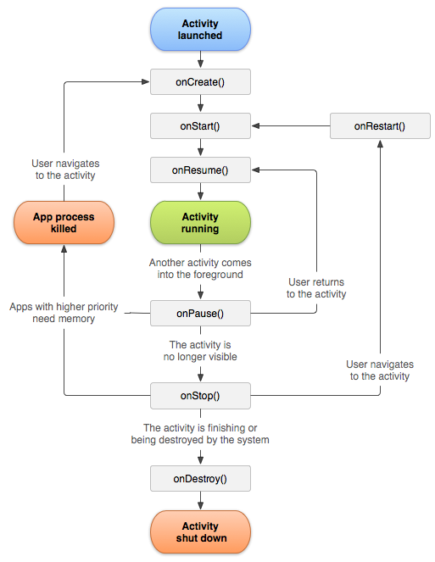
Activity Lifecycle
Notes:
onCreate()
You must implement this callback, which fires when the system creates your activity. Your implementation should initialize the essential components of your activity: For example, your app should create views and bind data to lists here. Most importantly, this is where you must call setContentView() to define the layout for the activity's user interface.
When onCreate() finishes, the next callback is always onStart().
onStart()
As onCreate() exits, the activity enters the Started state, and the activity becomes visible to the user. This callback contains what amounts to the activity’s final preparations for coming to the foreground and becoming interactive.
onResume()
The system invokes this callback just before the activity starts interacting with the user. At this point, the activity is at the top of the activity stack, and captures all user input. Most of an app’s core functionality is implemented in the onResume() method.
The onPause() callback always follows onResume().
onPause()
The system calls onPause() when the activity loses focus and enters a Paused state. This state occurs when, for example, the user taps the Back or Recents button. When the system calls onPause() for your activity, it technically means your activity is still partially visible, but most often is an indication that the user is leaving the activity, and the activity will soon enter the Stopped or Resumed state.
An activity in the Paused state may continue to update the UI if the user is expecting the UI to update. Examples of such an activity include one showing a navigation map screen or a media player playing. Even if such activities lose focus, the user expects their UI to continue updating.
You should not use onPause() to save application or user data, make network calls, or execute database transactions. For information about saving data, see Saving and restoring activity state.
Once onPause() finishes executing, the next callback is either onStop() or onResume(), depending on what happens after the activity enters the Paused state.
onStop()
The system calls onStop() when the activity is no longer visible to the user. This may happen because the activity is being destroyed, a new activity is starting, or an existing activity is entering a Resumed state and is covering the stopped activity. In all of these cases, the stopped activity is no longer visible at all. When your activity is no longer visible to the user, it has entered the Stopped state, and the system invokes the onStop() callback. This may occur, for example, when a newly launched activity covers the entire screen. The system may also call onStop() when the activity has finished running, and is about to be terminated.
When the activity moves to the stopped state, any lifecycle-aware component tied to the activity's lifecycle will receive the ON_STOP event. This is where the lifecycle components can stop any functionality that does not need to run while the component is not visible on the screen.
In the onStop() method, the app should release or adjust resources that are not needed while the app is not visible to the user. For example, your app might pause animations or switch from fine-grained to coarse-grained location updates. Using onStop() instead of onPause() ensures that UI-related work continues, even when the user is viewing your activity in multi-window mode.
The next callback that the system calls is either onRestart(), if the activity is coming back to interact with the user, or by onDestroy() if this activity is completely terminating.
onRestart()
The system invokes this callback when an activity in the Stopped state is about to restart. onRestart() restores the state of the activity from the time that it was stopped.
This callback is always followed by onStart().
onDestroy()
The system invokes this callback before an activity is destroyed.
This callback is the final one that the activity receives. onDestroy() is usually implemented to ensure that all of an activity’s resources are released when the activity, or the process containing it, is destroyed.

Slide 6
Intents
An Intent is a messaging object you can use to request an action from another app component.
Although intents facilitate communication between components in several ways, there are three fundamental use cases:
Starting an activity
Starting a service: A Service is a component that performs operations in the background without a user interface.
Delivering a broadcast: A broadcast is a message that any app can receive.
There are two types of Intent.
Explicit intents
Implicit intents

Slide 7
Intents
Explicit intents specify which application will satisfy the intent, by supplying either the target app's package name or a fully-qualified component class name.
You'll typically use an explicit intent to start a component in your own app, because you know the class name of the activity or service you want to start.
For example, you might start a new activity within your app in response to a user action, or start a service to download a file in the background.
Implicit intents do not name a specific component, but instead declare a general action to perform, which allows a component from another app to handle it.
For example, if you want to show the user a location on a map, you can use an implicit intent to request that another capable app show a specified location on a map.

Slide 8
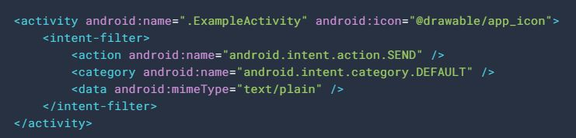
Activity: Intent filters
Intent filters are a very powerful feature of the Android platform.
Intent Filters are declared if you want to start receiving/communicating with other applications.
Ability to launch an activity based not only on an explicit request, but also an implicit one. For instance:
An explicit request might tell the system to “Start the Send Email activity in the Gmail app".
By contrast, an implicit request tells the system to “Start a Send Email screen in any activity that can do the job.“
It includes three elements
Action
Category
Data
Notes:
Intent Filters are declared if you want to start receiving/communicating with other applications. But if you don’t declare it then the activity will only be started through a explicit intent.
The following code snippet shows how to configure an activity that sends text data, and receives requests from other activities to do so:
In this example, the <action> element specifies that this activity sends data. Declaring the <category> element as DEFAULT enables the activity to receive launch requests. The <data> element specifies the type of data that this activity can send.
If you intend for your app to be self-contained and not allow other apps to activate its activities, you don't need any other intent filters. Activities that you don't want to make available to other applications should have no intent filters, and you can start them yourself using explicit intents

Slide 9
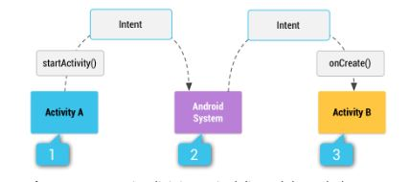
IMPLICIT Intent
How an implicit intent is delivered through the system to start another activity:
Step 1: Activity A creates an Intent with an action description and passes it to startActivity()
The Android System searches all apps for an intent filter that matches the intent.
When a match is found, the system starts the matching activity (Activity B) by invoking its onCreate() method and passing it the Intent.

Slide 10
Thank You!

